Slide 1
Credit Card Fraud Capstone Project Presentation
By – Nikhil Bhati

Slide 2
AGENDA:
Objective
Background
Key findings
Recommendations
Appendix:
Data Sources
Data Methodology
Data model assumptions
Video Submission for PPT Link

Slide 3
Objective
Improvise the strategies to be able to catch more fraud transactions.
Understand the key insights from the analysis of the credit card fraud.
Estimate the factors affecting customer’s transactions through the 2 years time period.

Slide 4
Background
In recent times, the number of fraud transactions has increased drastically due to which credit card companies are facing a lot of challenges.
For many banks, retaining high profitable customers is the most important business goal. Banking fraud, however, poses a significant threat to this goal.
In the banking industry, detecting credit card fraud using machine learning is a necessity for the banks, as they need to put proactive monitoring and fraud prevention mechanisms in place.

Slide 5
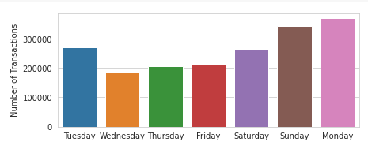
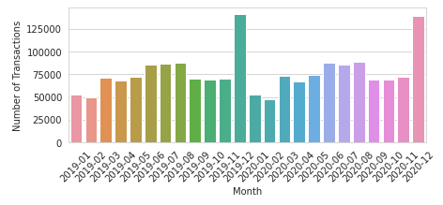
Most transactions happen on Mondays but it’s different during December
As we can see most of the expenditure is done around Monday as it is the start of a new week which can include weekly rations.
But this does not seem like a scenario for the month of December as it is the month of Holidays where people buy allot of gifts and stuff for themselves as there are also allot of sales around that month.
Month December has the highest transactions for both the years as it is a festive month.

Slide 6
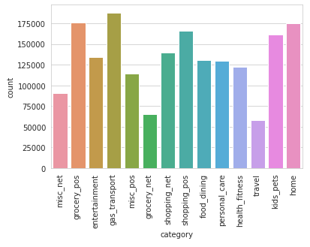
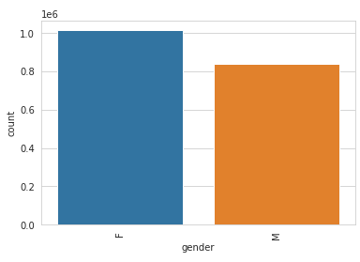
Customer’s highest preferred transaction is gas_transport
Highest number of transactions are done are for gas_transport. While least number of transactions are done for travel.
The next preference is home and grocery_POS. Follow up by kids_pets as thrid highest.
In comparison it can be seen that Females are more keen about spending funds as compared to the male gender.

Slide 7
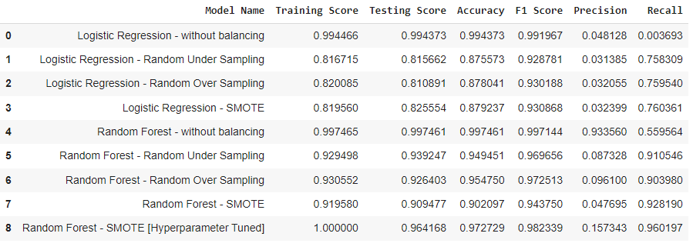
The best suited model
As we can see Accuracy is the highest of the imbalanced logistic regression model, but precision and recall are awfully low.
Random Forest SMOTE is the best option even though the Accuracy and recall is a bit low than the others as Over sampling copy and add data and under sampling leads to loss of data.
After hyper parameter tuning Random Forest SMOTE’s accuracy and Recall has increased making it the best model to choose.

Slide 8
Recommendations
Banks should be paying more attention to the transactions happening during the least active days to prevent fraud.
Giving more attention to the unusual activity such as unusual purchases through the credit card.
Picking the most optimum model by making sure the results are balanced and not only focused on Accuracy. And then get it to hyper parameter tuning.

Slide 9
Appendix – Data sources
Following data was used for the analysis:
Credit card fraud test and train CSVs
The data is from 2019 to 2020.
Below is a brief snapshot of the data combined:

Slide 10
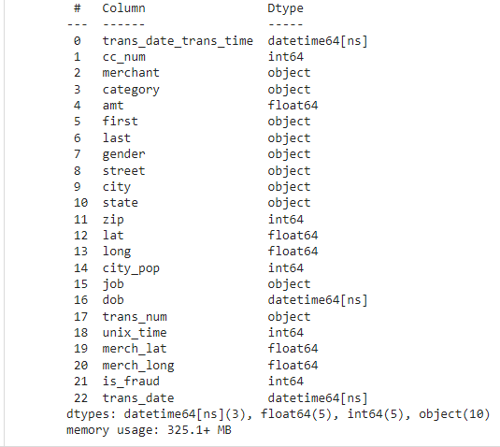

Slide 11
Appendix – Data Methodology
We conducted a thorough analysis on the credit card fraud. The process included:
The reading of data, processing and pre-processing.
Then we clean the data and look for any missing values while also drop the columns which won’t come handy for further analysis.
Next we do the EDA to be able to get the key points from the given data before we start building models.
Then we turn data such as gender into binary data of M: 1 and F : 0 for model building.
Then we make few models and select the best one for hyper parameter tuning.
In the end we did cost analysis.

Slide 12
Appendix – Data model assumptions
The best model to use and hyper parameter tune is Random Forest Smote as it has the balanced factors while also not risking variations in data.
Transactions that were the most on December of the both year, which also point that there could be allot of frauds around those months but also as it is a very festive month.
Any unusual transaction that does not associate with the normal transactions of the customers should be looked into the most to avoid fraud.

Slide 13
Video submission for ppt link:
https://drive.google.com/file/d/1eUst6kvxzCvg6s4FP-P3k-4Hl72h8C0p/view?usp=sharing
Please copy and paste the above link

